Slide 1
1. Time-dependence (cont.) 2. Uncertainty
Ivy Tsai
20231031

Slide 2
Agenda 20231031
1st hour: quick review and R package – time-varying values
2nd hour: video and self-study
3rd hour: discussion – uncertainty/heterogeneity
Homework for 20231107:
Exercise 3.5 Hip Fracture (MUST)
Videos (if no time to read Briggs and Edlin)

Slide 3
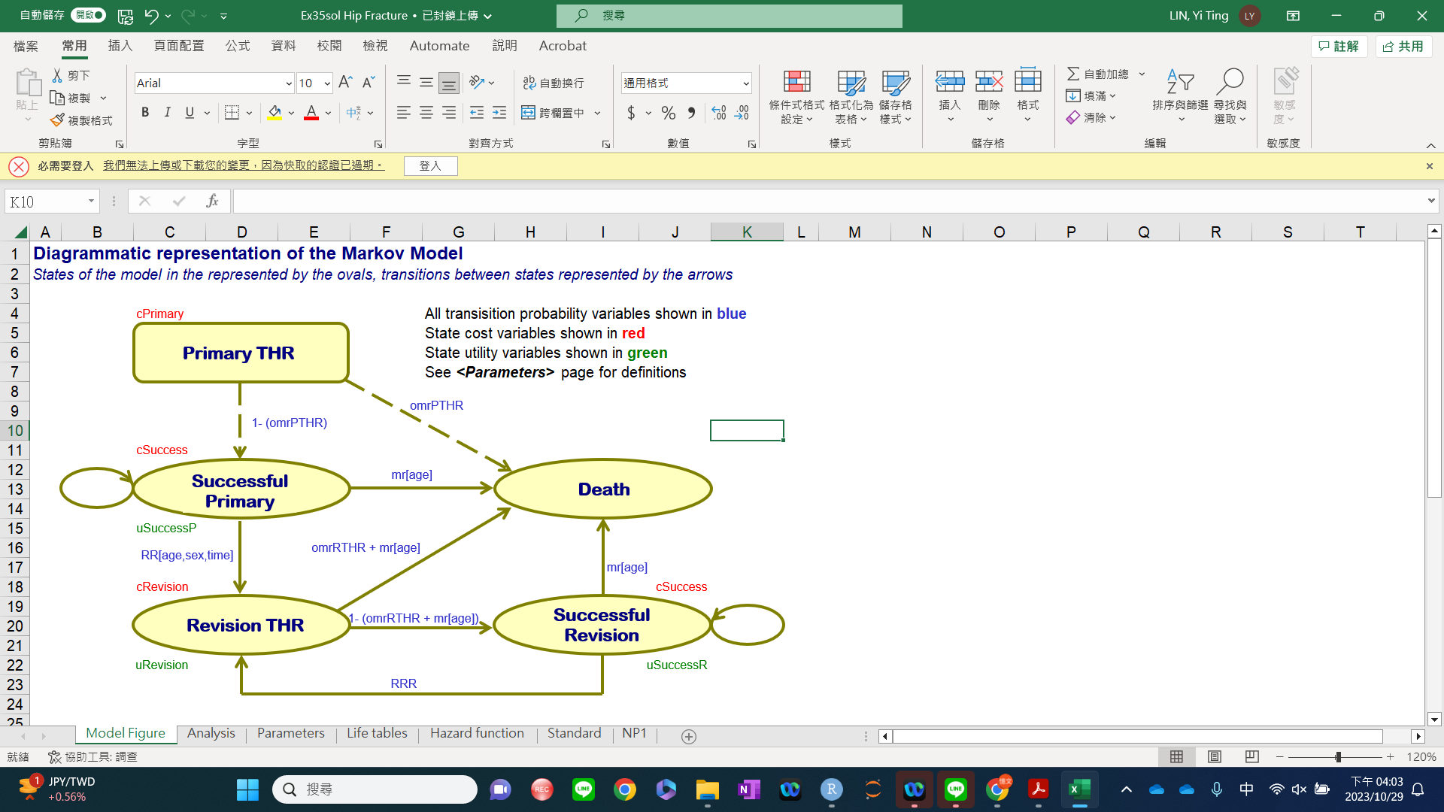
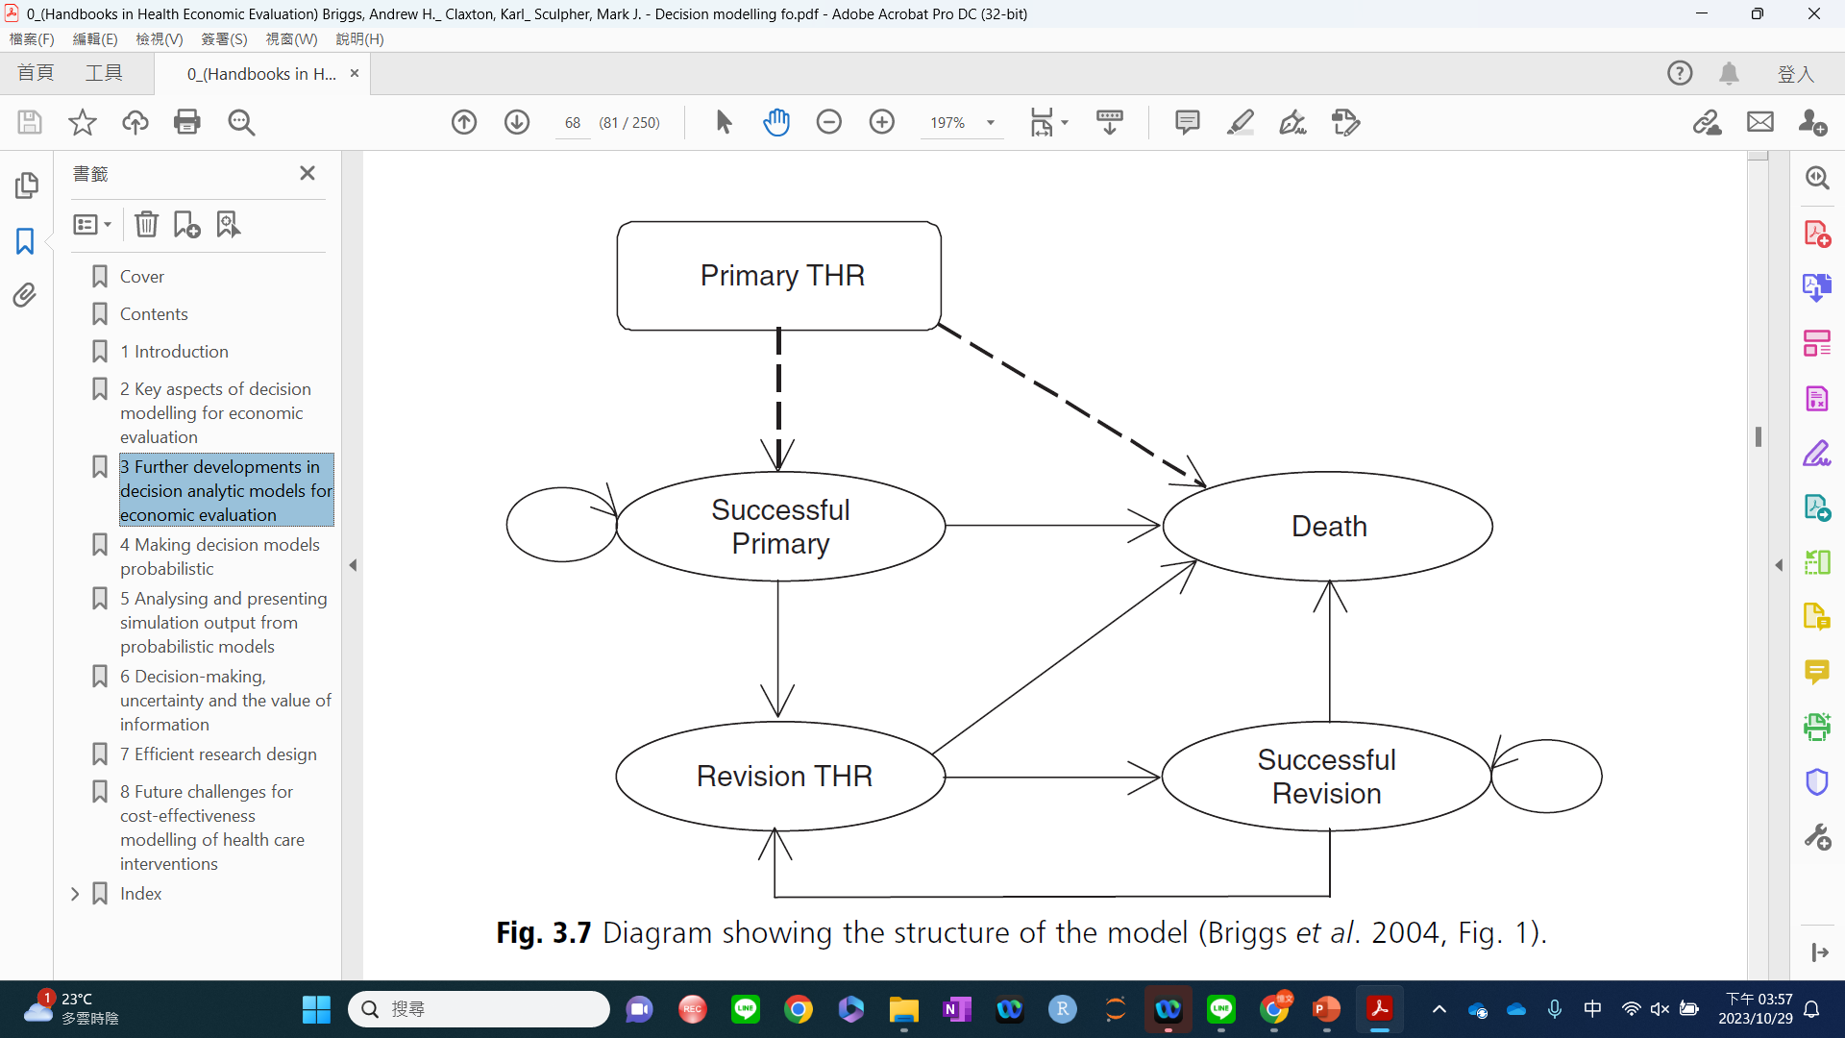
Exercise 3.5 Hip Fracture
Page 67-75
https://www.herc.ox.ac.uk/downloads/decision-modelling-for-health-economic-evaluation

Slide 4
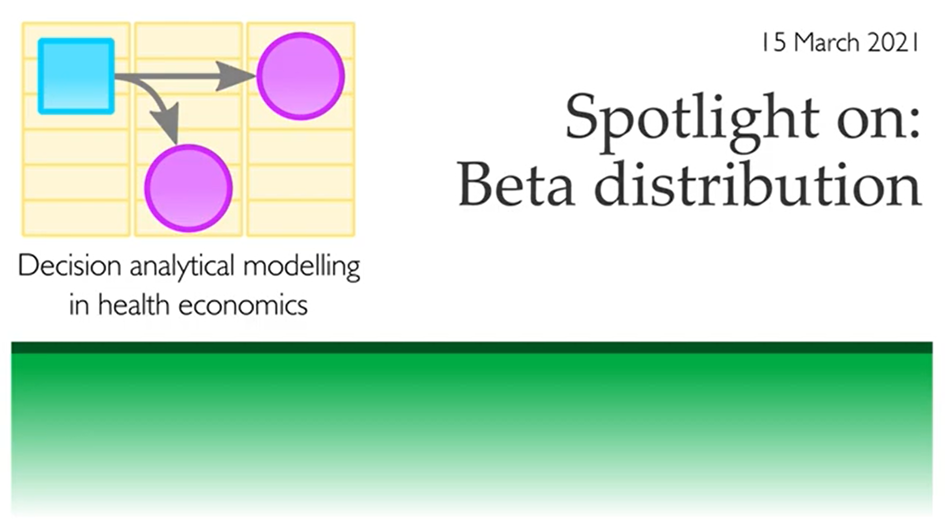
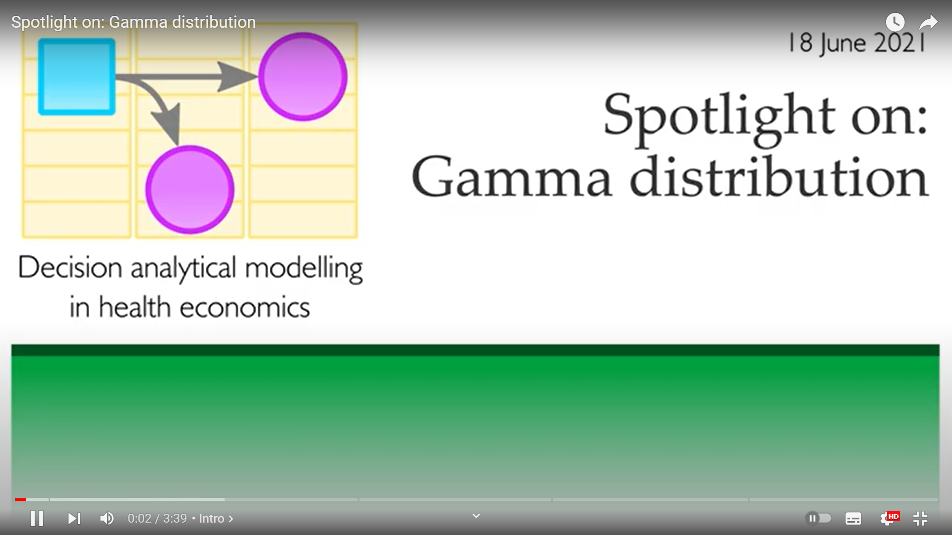
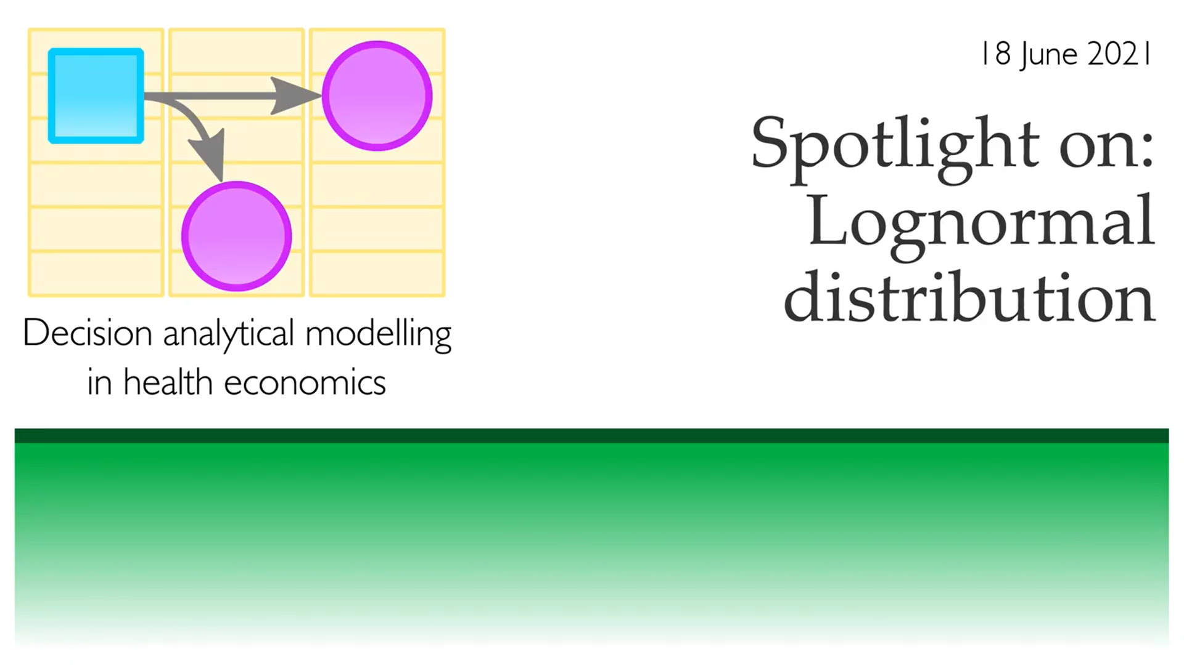

Spotlight on: Beta distribution
https://www.youtube.com/watch?v=i8KvU-ODqgA
Spotlight on: Gamma distribution
https://www.youtube.com/watch?v=-pIIVcwq6NI
Spotlight on: Lognormal distribution
https://www.youtube.com/watch?v=qxQ2GC1uYjs
Spotlight on: Chi-square distribution
https://www.youtube.com/watch?v=rtv7elZT-OQ

Slide 5
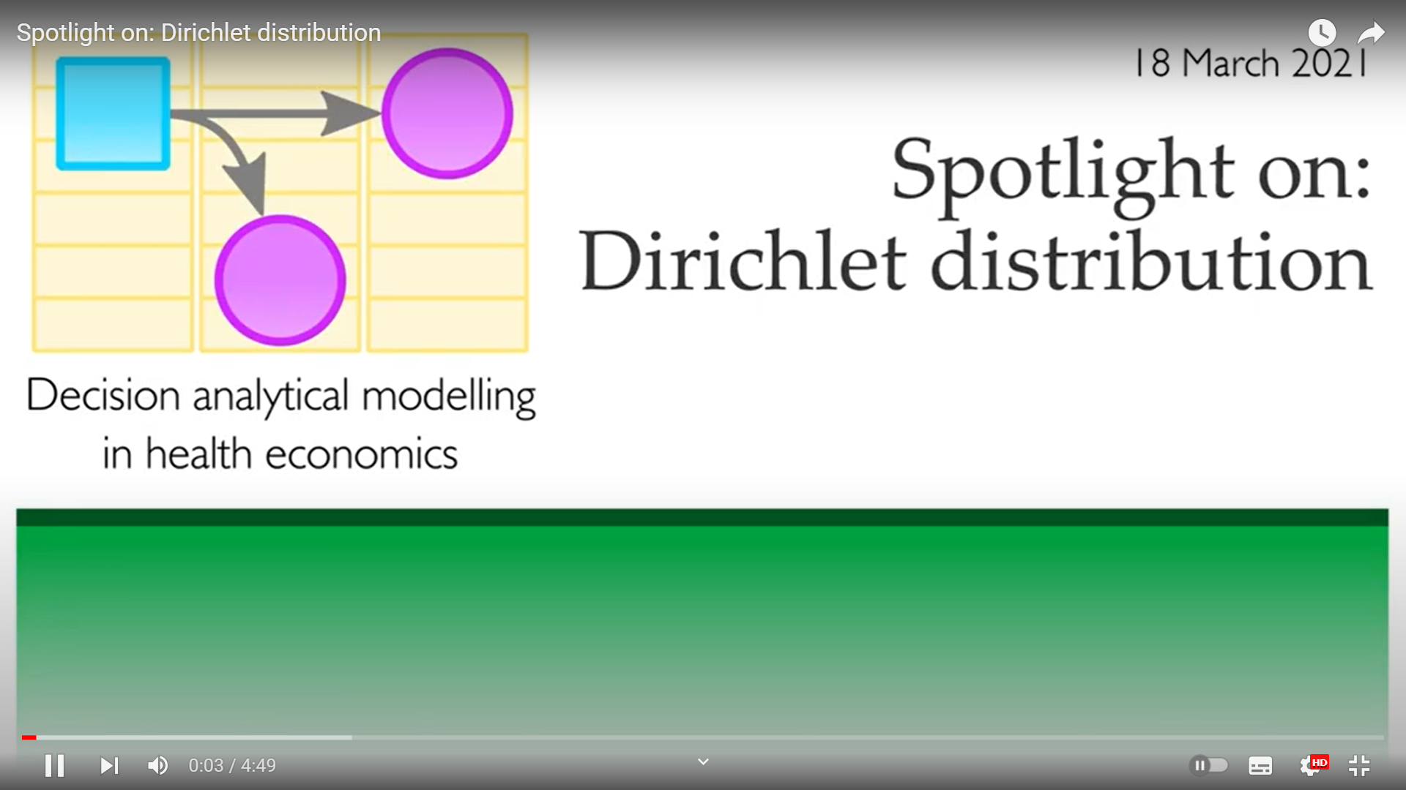
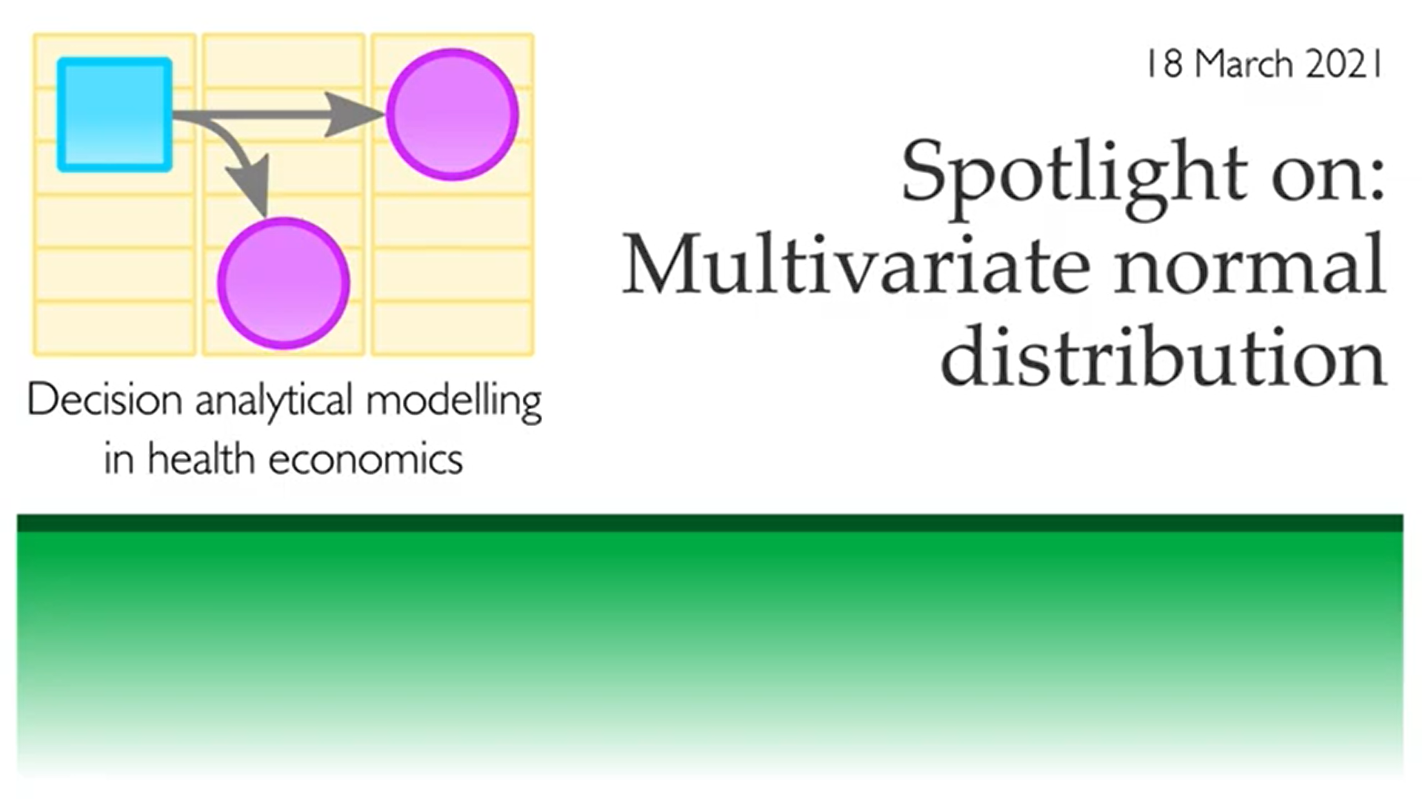
Spotlight on: Dirichlet distribution
https://www.youtube.com/watch?v=eOOzVyBDHjc
Spotlight on: Multivariate normal distribution
https://www.youtube.com/watch?v=X3sbaqJ2tcY

Slide 6
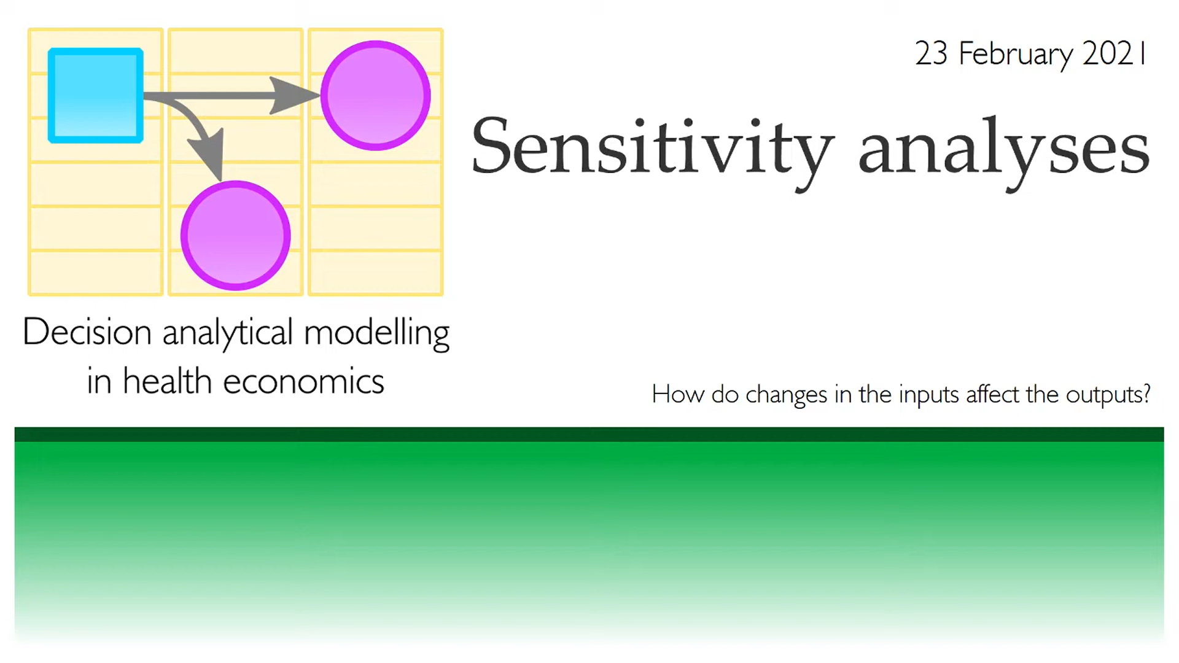
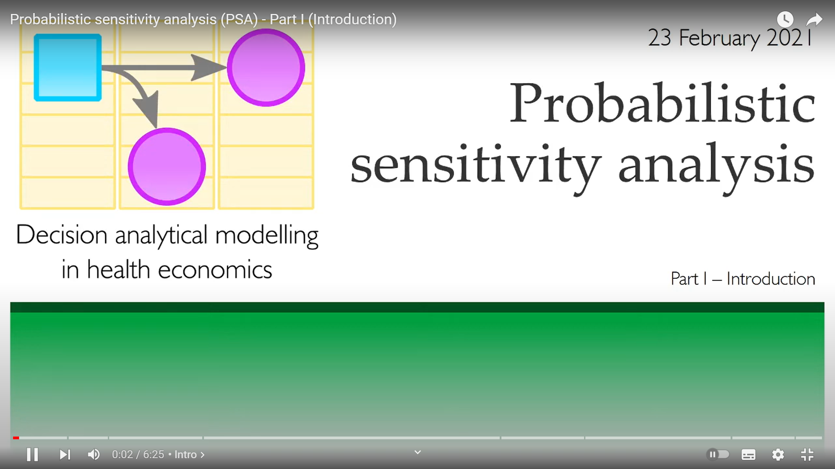
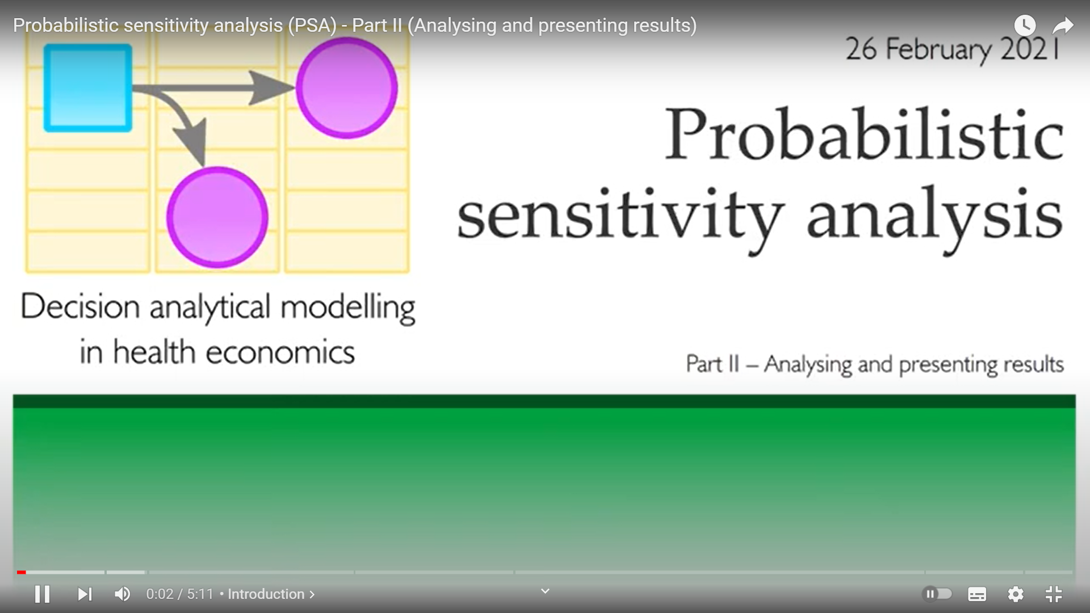
Sensitivity analyses in cost-effectiveness modelling
https://www.youtube.com/watch?v=1txk9FUsIbw&list=PLIT7NqYN7YT3LNYOoTEFchRXX7crLfYa5&index=10
Probabilistic sensitivity analysis (PSA) - Part I (Introduction)
https://www.youtube.com/watch?v=Mnftc8V0pU4
Probabilistic sensitivity analysis (PSA) - Part II (Analysing and presenting results)
https://www.youtube.com/watch?v=cTEceyHOqQQ

Slide 7

Uncertainty in decision model
York Materials

Slide 8
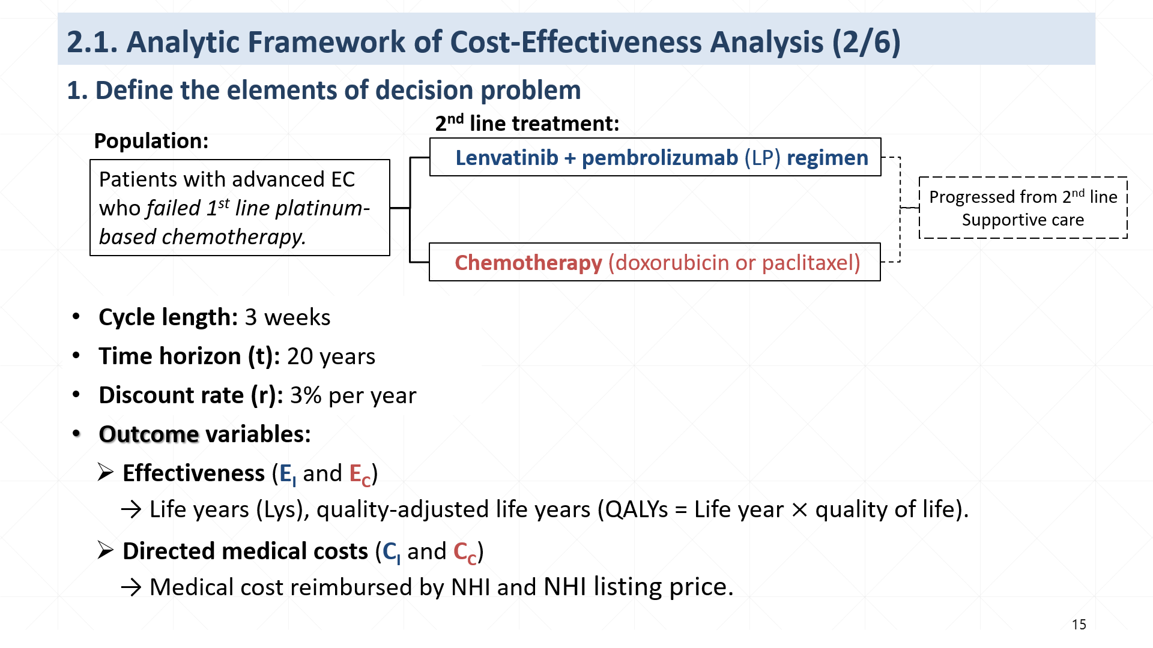
Case 1

Slide 9
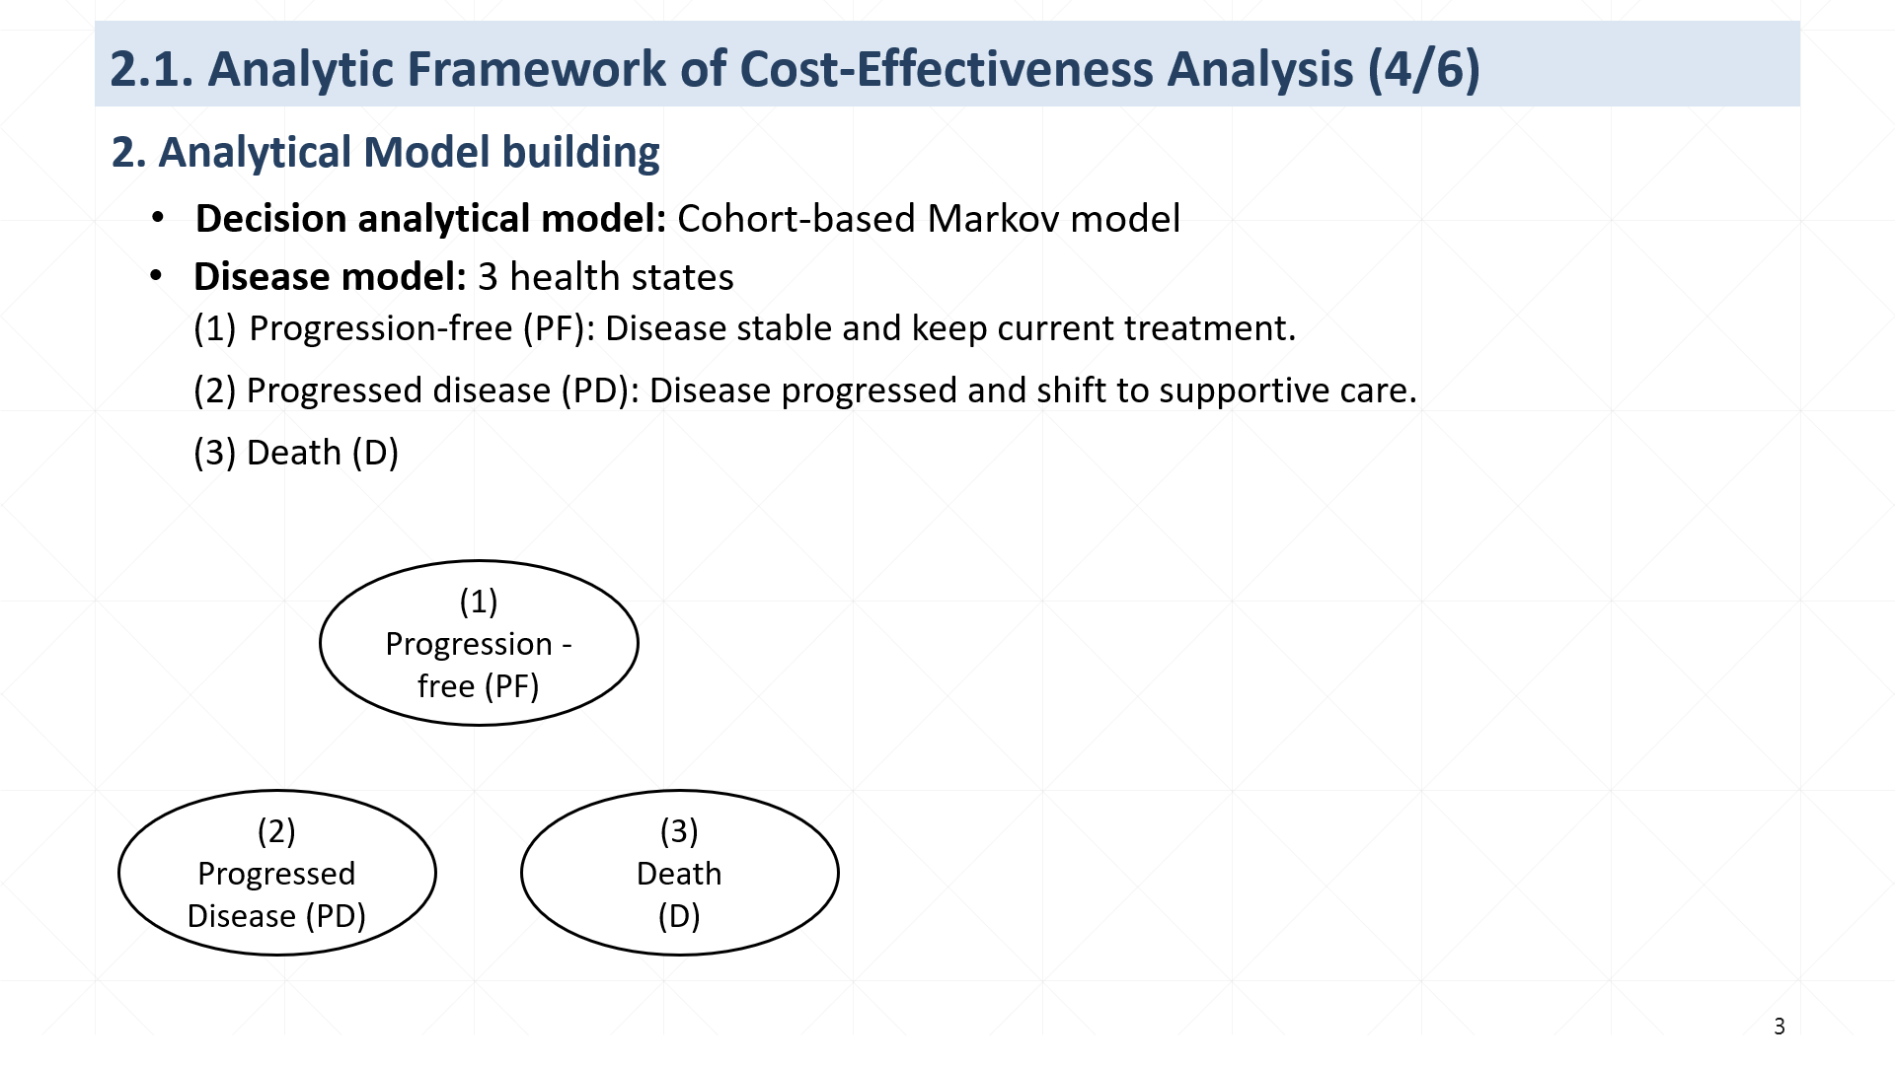

Case 1
3 health states
1000
(1) Progression-free
(2) Progressed disease
(3) Death
1-p1-p3
(1) Progression -free (PF)
Cycle 0
1000
0
0
tp*=1-p1-p3
p1
p3
Cycle 1
N_{PF1}=1000*(1-p1-p3)
N_{PD1}=1000*p1
N_{D1}=1000*p3
p3
p3
1-p2
p2
1
1-p2
p1
1
1-p1-p3
p1
Cycle 2
N_{PF1}*(1-P1-P3)
[N_{PF1}*p1)]
+[N_{PD1}*(1-p2)]
N_{D1}+(N_{PF1}*p3)
+(N_{PD1}*p2)
(2) Progressed
Disease (PD)
(3)
Death
(D)
p2
…….
…….
…….
…….
T
N_{PF(T-1)}*(1-P1-P3)
[N_{PF(T-1)}*p1)]
+[N_{PD(T-1)}*(1-p2)]
N_{D(T-1)}+(N_{PF(T-1)}*p3)
+(N_{PD(T-1)}*p2)
p = probability
*tp = transition probability
Notes:
Markov model中的疾病模式有三個健康狀態，
第一個健康狀態progression-free state 是指疾病沒有惡化，並且持續接受二線治療方案直到guideline指示的最高總劑量。
第二個健康狀態progressed disease 是指腫瘤惡化，在這state，會終止二線治療，改以症狀控制的支持性療法。
第三個健康狀態是 death 死亡。
我的Markov model ，病患都是從開始接受二線治療的progression free state進入Markov model，
在接受治療的過程中，每經過一個cycle，健康狀態就會隨著轉移機率(transition probability)而改變，
一直到完成time horizon

Slide 10
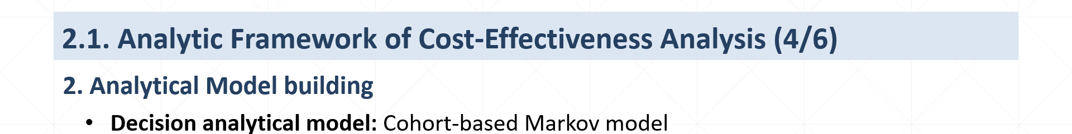
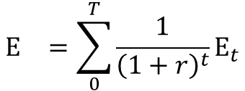
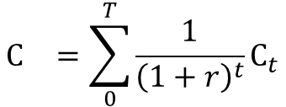
Case 1
2. Analytical Model building
Decision analytical model: Cohort-based Markov model
Cumulated outputs: E_{I,} E_{C,} C_{I,} and C_{C}
$$E_{}^{}=\sum_{0}^{T}{{\frac{1}{{\left(1+r\right)}^{t}}\text{E}}_{t}}$$
$$C_{}^{}=\sum_{0}^{T}{{\frac{1}{{\left(1+r\right)}^{t}}\text{C}}_{t}}$$
Cycle | Effectiveness (E) (Unit: LYs, QALYs*) | Cost (C) (Unit: NTD)
0 | E₀ ₌ E_{PF0} | C₀ = C_{PF0}
1 | E₁ = E_{PF1} +E_{PD1} | C₁ = C_{PF1}+ C_{PD1}+C_{D1}
2 | E₂ = E_{PF2} +E_{PD2} | C₂ = C_{PF2}+ C_{PD2}+C_{D2}
……. | ……. | …….
T | E_{T} = E_{PFT} +E_{PDT} | C_{T} = C_{PFT}+ C_{PDT}+C_{DT}
3 health states
(1) Progression-free
(2) Progressed disease
(3) Death
Cycle 0
1000
0
0
Cycle 1
N_{PF1}
N_{PD1}
N_{D1}
Cycle 2
N_{PF2}
N_{PD2}
N_{D2}
…….
…….
…….
…….
T
N_{PFT}
N_{PDT}
N_{DT}
*LYs = life years, QALYs = quality-adjusted life years.
Notes:
接下來要介紹估算effectiveness及medical cost 的方式，
隨著cycle的累進，健康狀態的轉變，我會估算每個cycle下的effectiveness和cost
經過3% discount，最後一起加總，估計出intervention組20年time horizon累計的cumulative effectiveness及cumulative cost還有comparator組累計的cumulative effectiveness及cumulative cost，分別就是EI EC CI和CC

Slide 11
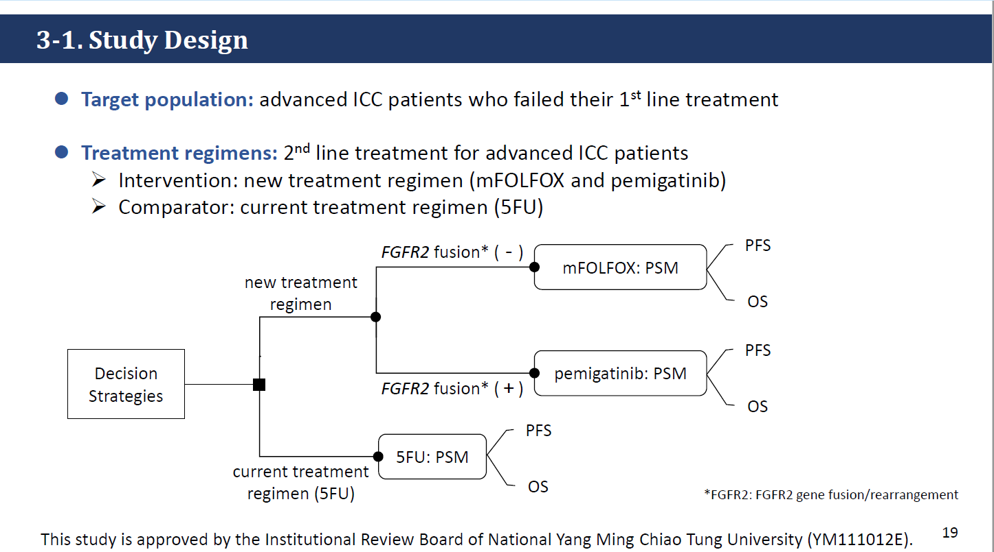
Case 2

Slide 12
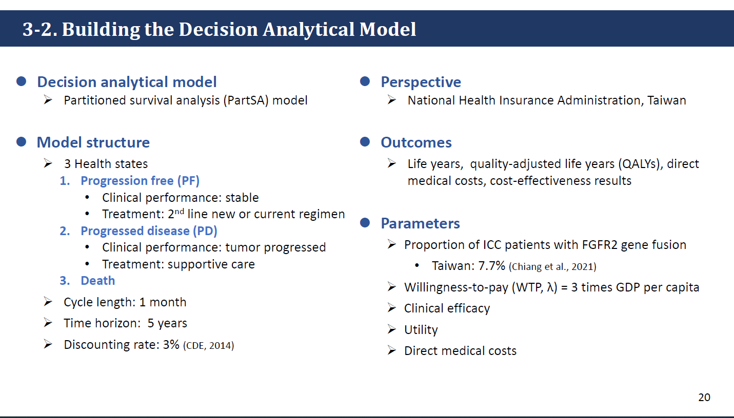
Case 2

Slide 13
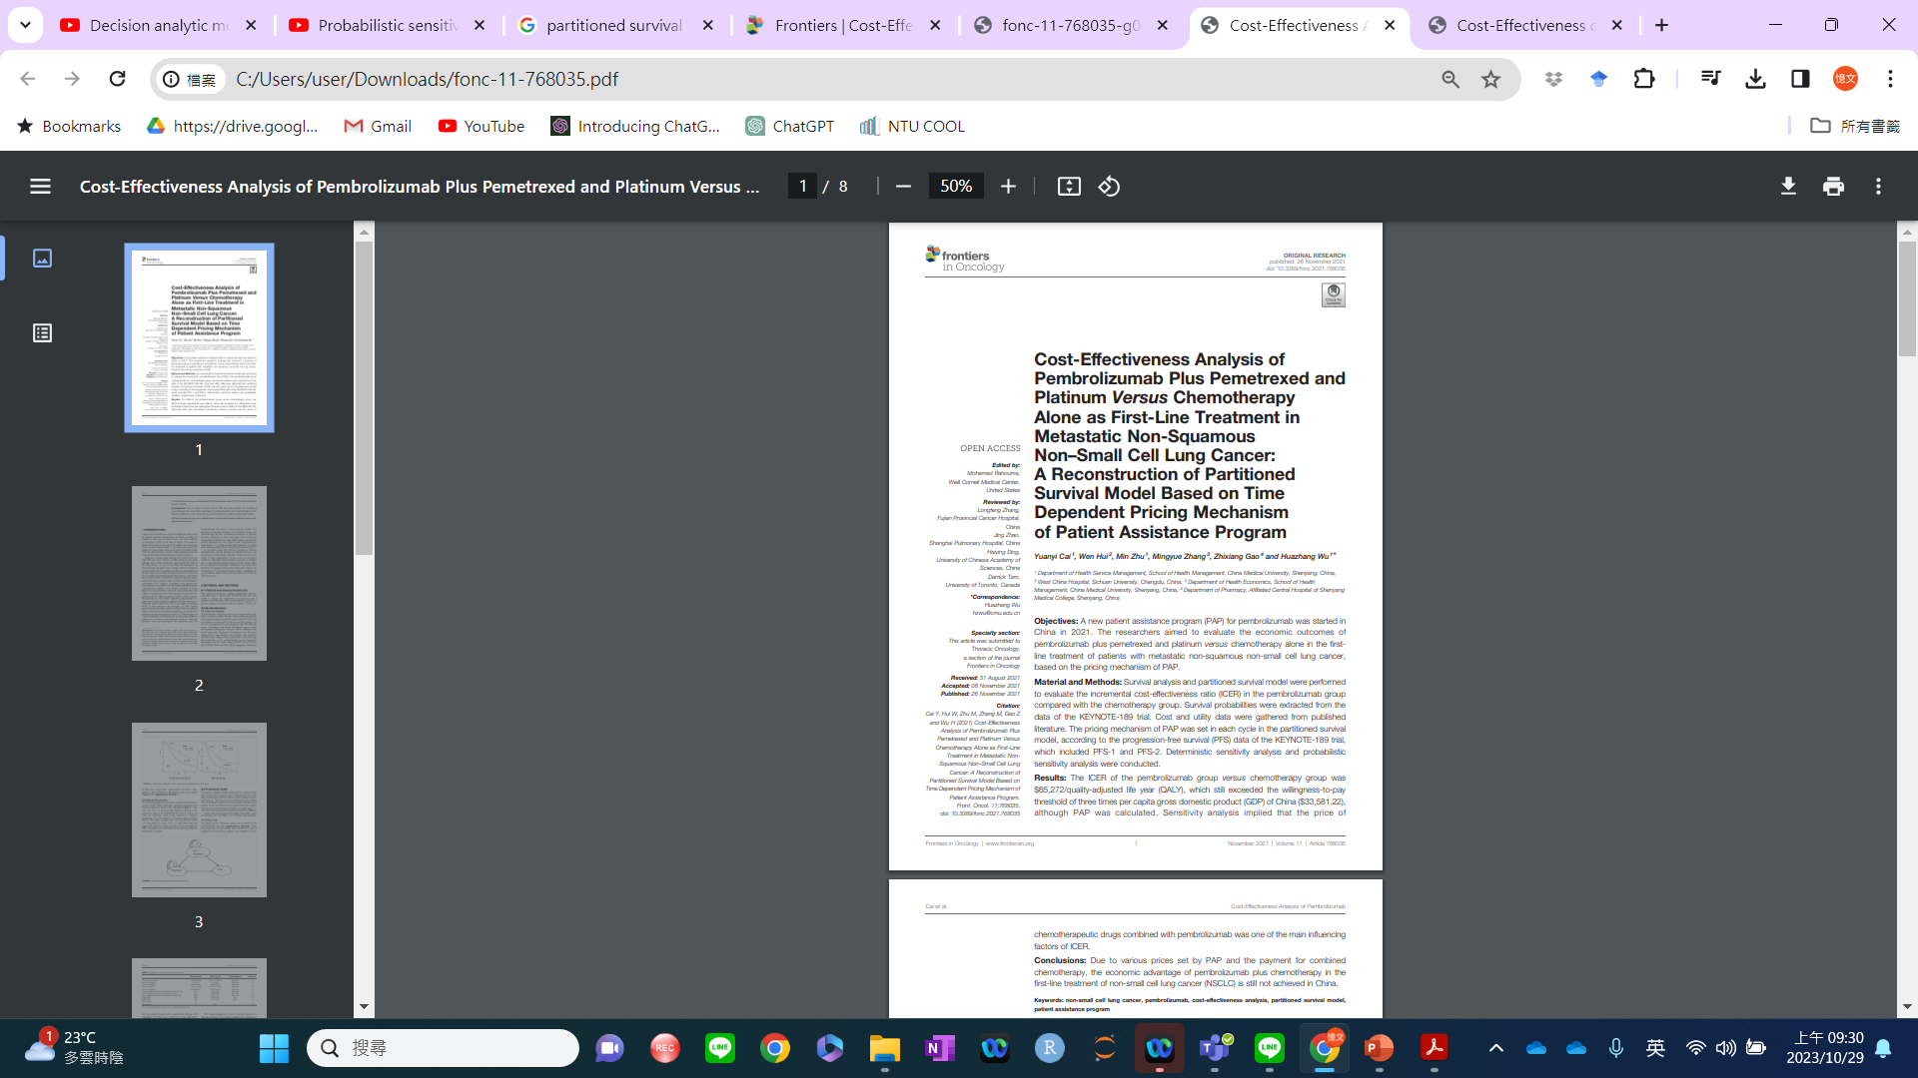
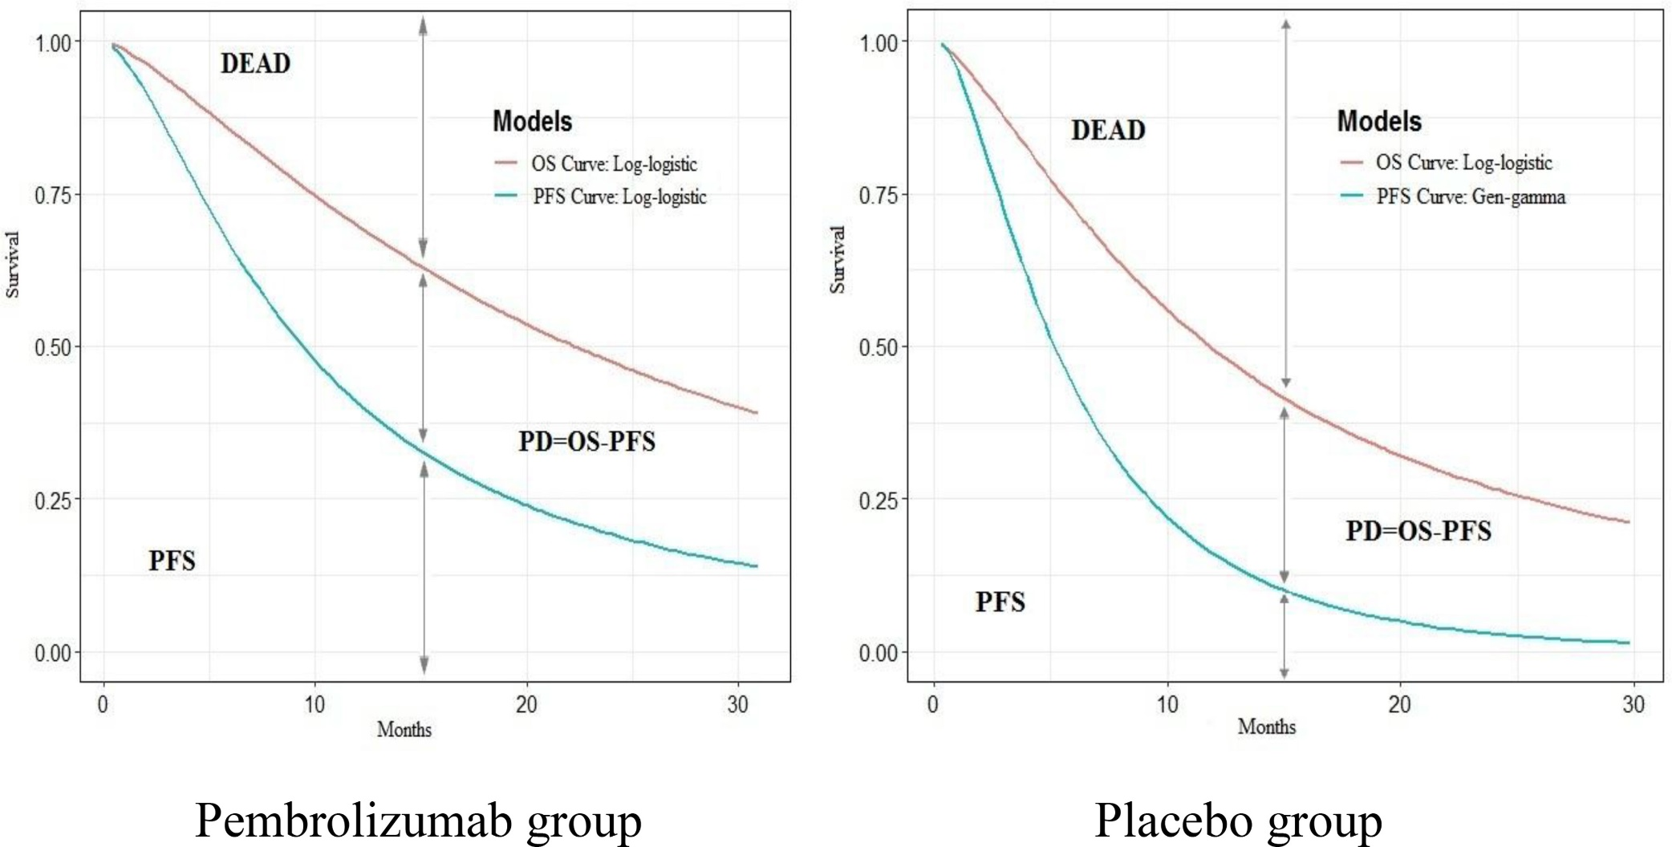
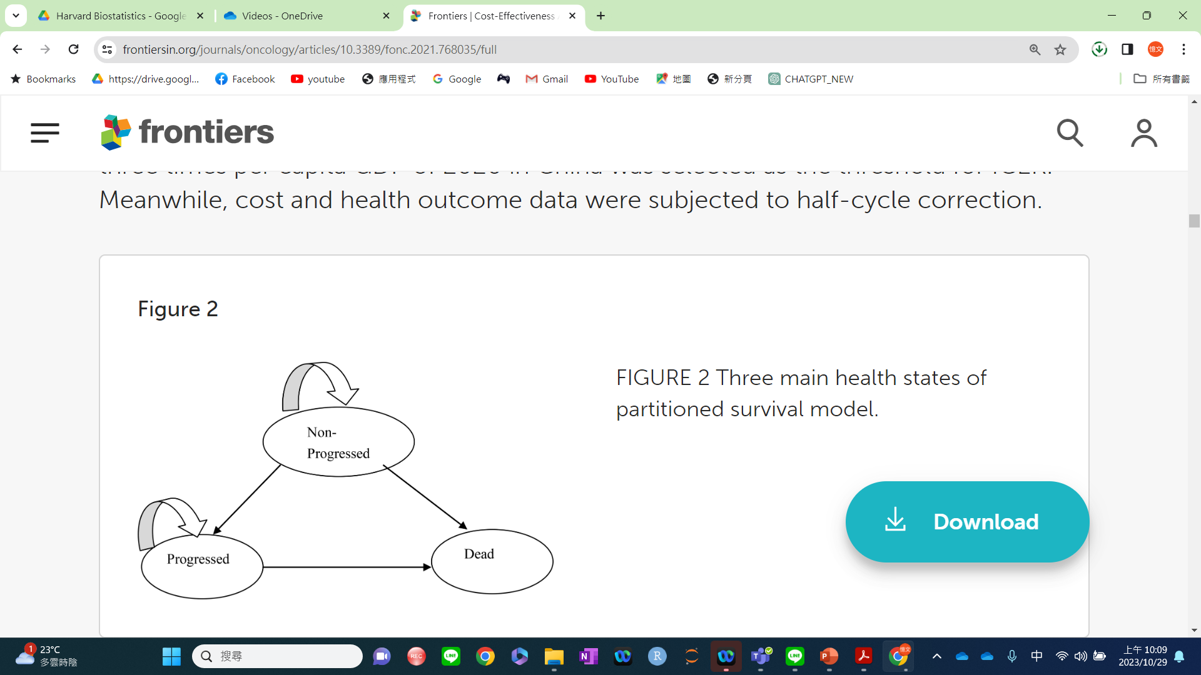
Partitioned Survival Model
Case 2
https://www.frontiersin.org/journals/oncology/articles/10.3389/fonc.2021.768035/full
Intervention group
Comparator group

Slide 14
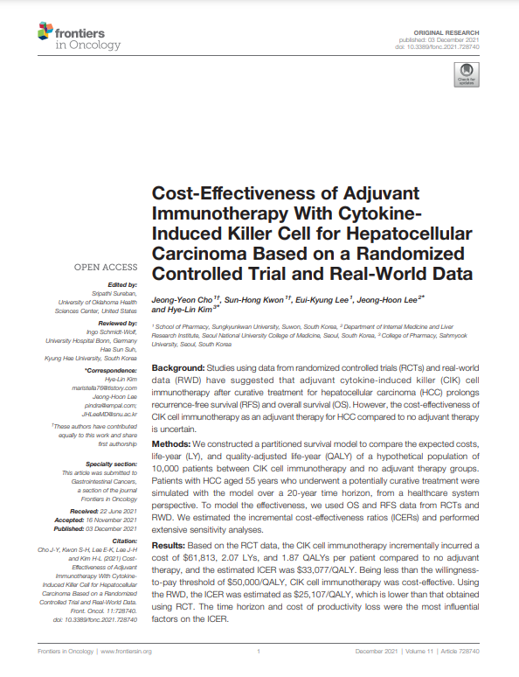
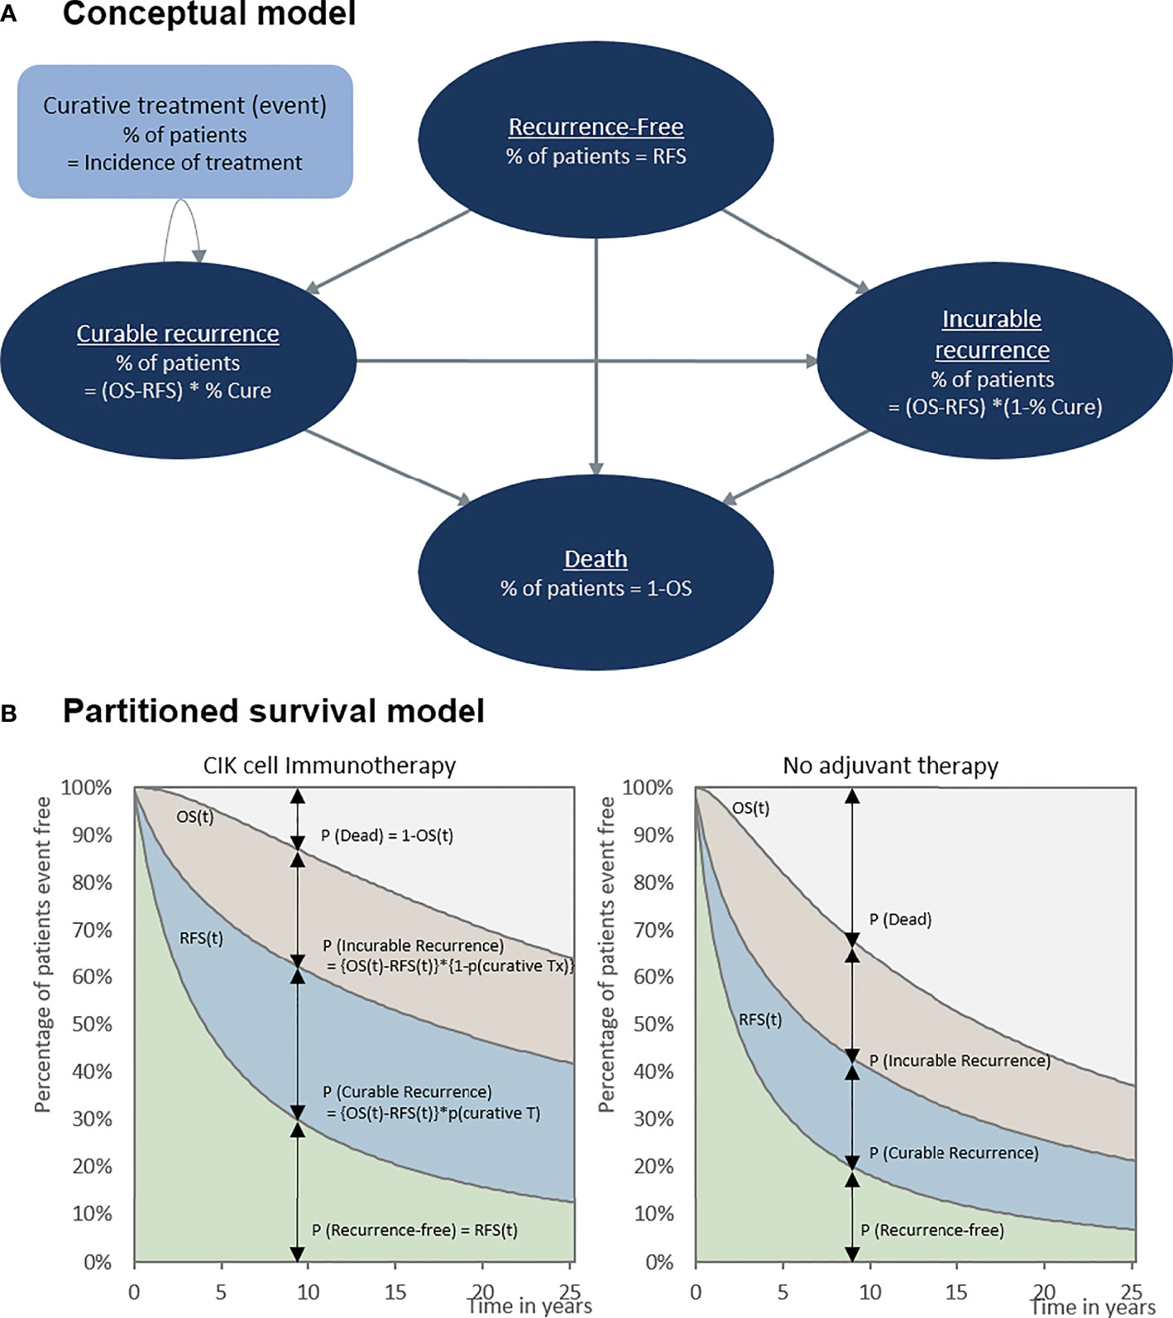

Partitioned Survival Model
https://www.frontiersin.org/journals/oncology/articles/10.3389/fonc.2021.728740/full

Slide 15
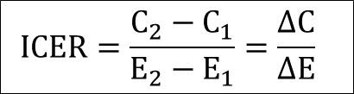
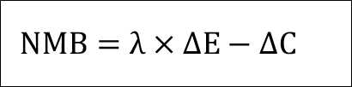
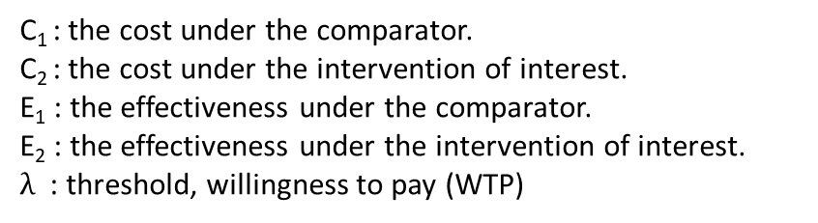
Case 2
3-4. Cost-effectiveness Analysis: Base-Case Analysis
Incremental cost effectiveness ratio (ICER)
The cost per unit of the health outcome/effect.
Function:
$$ICER=\frac{C_{2}−C_{1}}{E_{2}−E_{1}}=\frac{ΔC}{ΔE}$$
Decision criteria
ICER < λ
NMB > 0
Net monetary benefit (NMB)
Function:
$$NMB=λ×ΔE−ΔC$$
λ = 3 times of GDP per capita in Taiwan (2021)
C₁ : the cost under the comparator.
C₂ : the cost under the intervention of interest.
E₁ : the effectiveness under the comparator.
E₂ : the effectiveness under the intervention of interest.
$λ$ : threshold, willingness to pay (WTP)
(Edlin et al., 2015; Gray et al., 2010)
Notes:
參數輸入決策分析模型後，利用TreeAge軟體執行成本效益分析，
成本效益分析結果以公式計算得出
Incremental cost-effectiveness ratio遞增成本效果比值(ICER)
Net monetary benefit淨貨幣效益(NMB)
# 決策標準為 ICER< λ，以及NMB>0

Slide 16
Case 2
4-2. Base Case Analysis
Base-case: Cost-effectiveness outcomes in 5 years
 | Current regimen (5FU) | New regimen (mFOLFOX/pemigatinib) | Incremental change
Cost | 524,472 | 984,168 | 459,697
Total cost of PF state | 369,229 | 795,614
Genetic test cost | 0 | 30,000
Medication costs (PF) | 63,430 | 387,176
Non-medication cost (PF) | 305,799 | 378,437
Total cost of PD state | 155,243 | 188,555
Life years
Progression-free | 0.36 | 0.48 | 0.12
Overall | 0.67 | 0.86 | 0.19
Quality-adjusted life years
Progression-free | 0.26 | 0.35 | 0.09
Overall | 0.47 | 0.61 | 0.13
Incremental cost per QALY (ICER) |  |  | 3,411,098
NMB |  |  | -70,269
LYs: life years, QALYs: quality-adjusted life years, ICER: incremental cost-effectiveness ratio, NMB: net monetary benefit
WTP (λ) = 3 times GDP (NT$2,889,684)
Findings:
ICER (NT$ 3,411,098) > WTP (NT$2,889,684)
NMB (NT$ -70,269) < 0
NOT cost-effectiveness in base-case analysis!
Notes:
成本效益的base case分析結果顯示五年追蹤下，
與current regimen相比，new regimen高出 #約【46萬】元的成本，# 增加了0.19個 life year， # 以及0.13個QALY。
# 得到的ICER值約為每增加一個QALY需多花費341萬元的成本， Net monetary benefit 約為 【-7萬】元。
# 依據決策標準，ICER 值高於3 GDP 的threshold，且NMB小於0。
# 表示新治療方案不符合成本效益

Slide 17
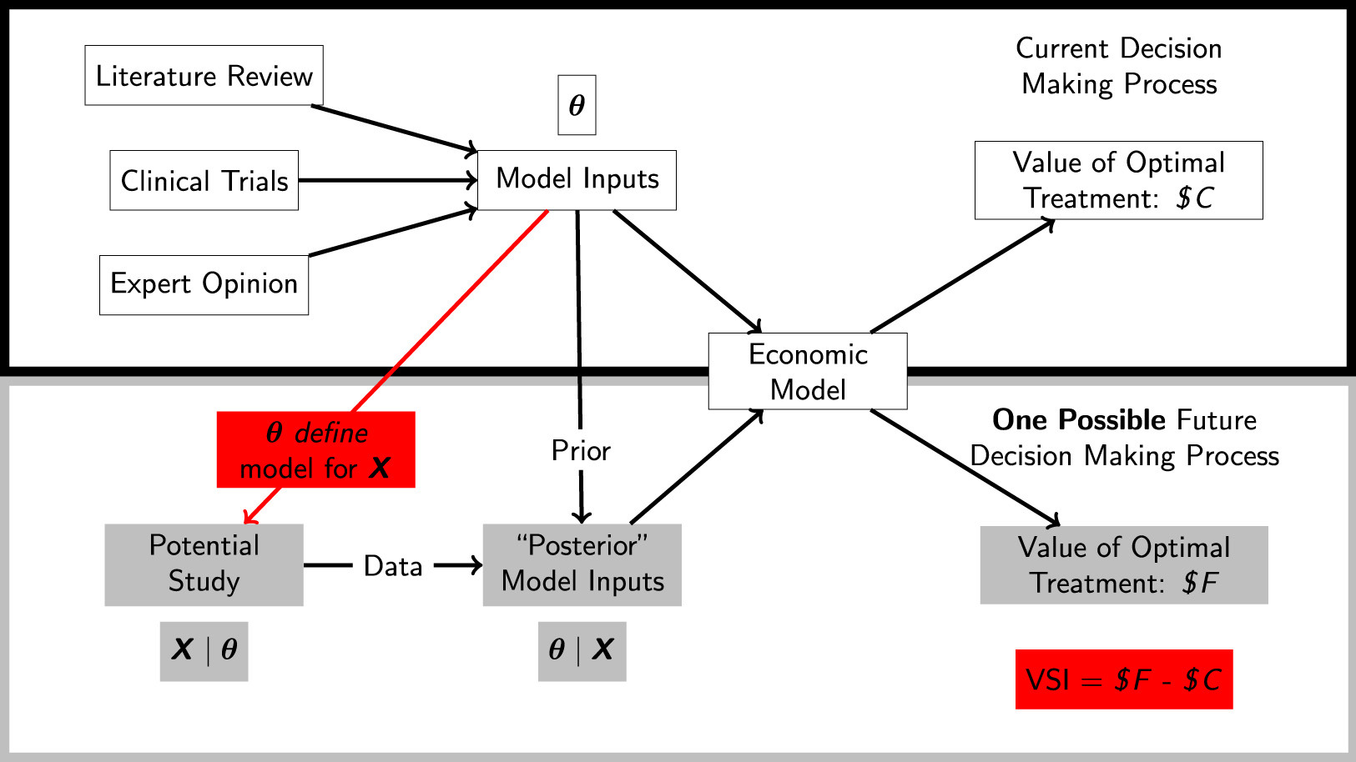
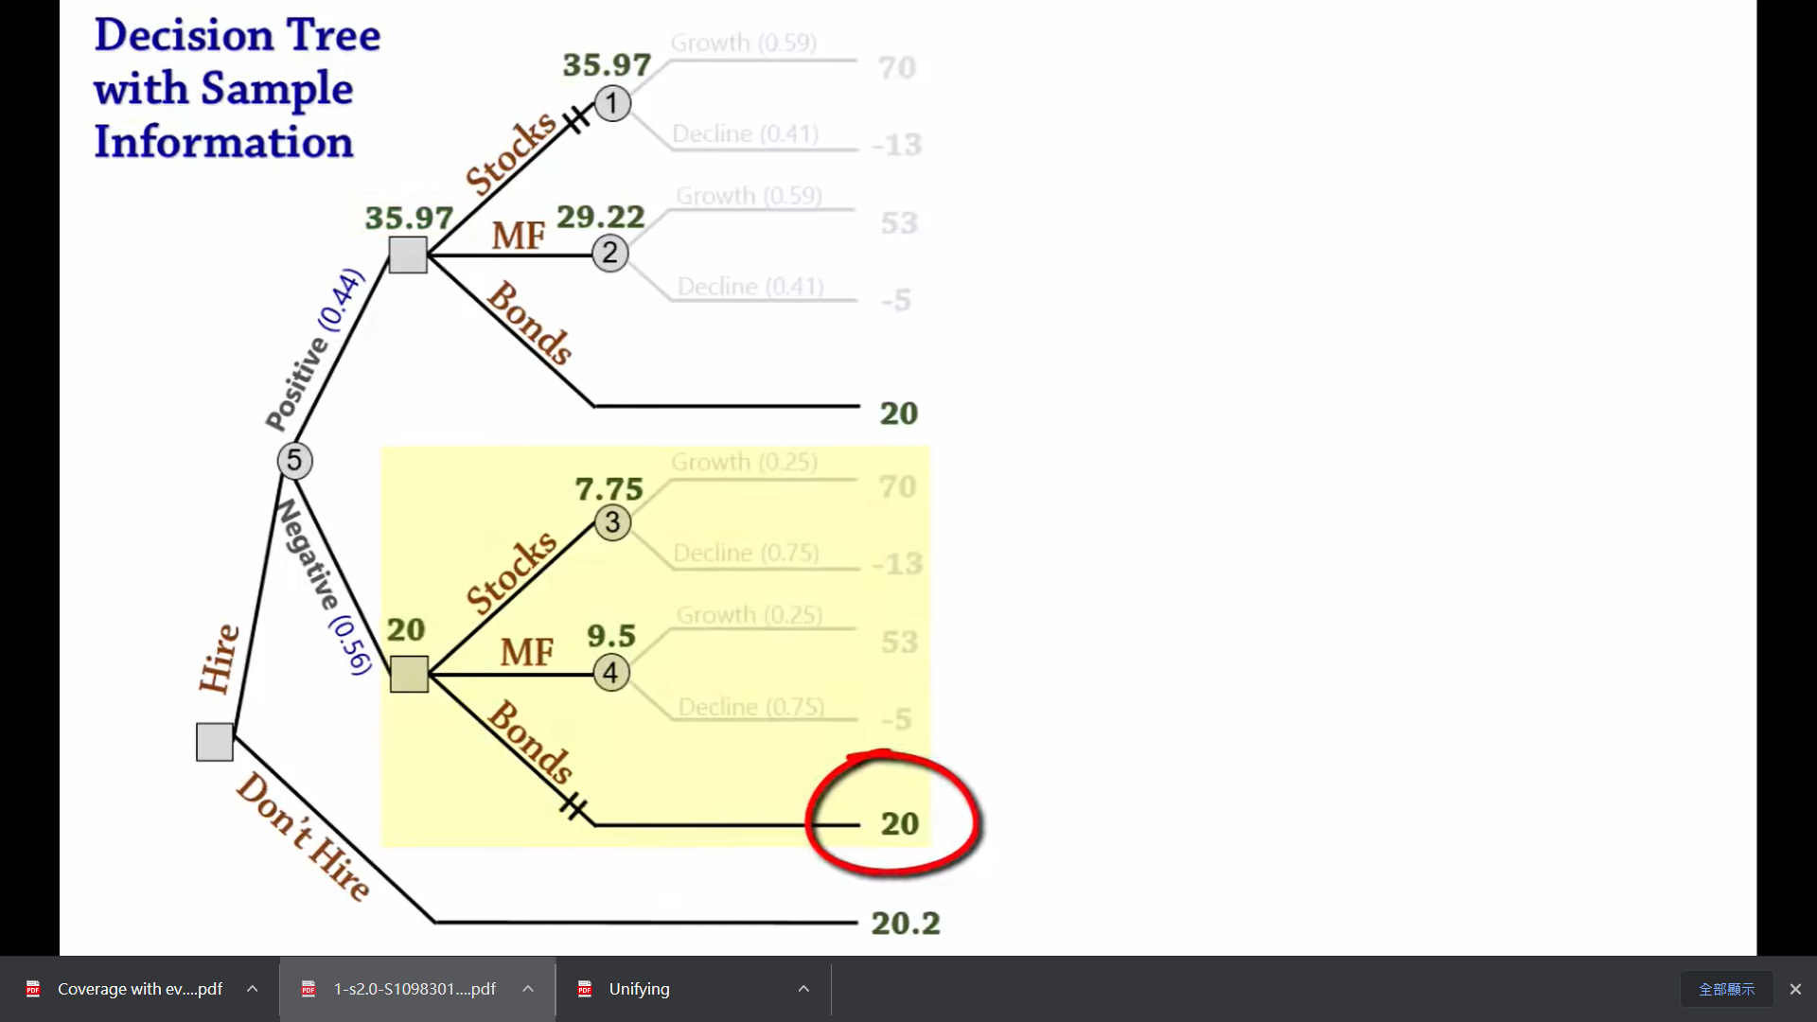
Explore beyond the surface
Look beneath the surface
https://www.youtube.com/watch?v=FUY07dvaUuE&list=RDCMUC1S4Jeodbr5EbsCOIgBWJPQ&index=1
(Figure sourced from the internet)
0:33

Slide 18
Q1: When we make decisions based on point estimates in cost-effectiveness analysis, what potential issues or concerns are there?
Why and what do we (have to) be worried or concerned about the “evidence-based” decision?
Why?
An inadequate or wrong decision:
Harms: irreversible damage (lost life years)
Opportunity cost: irreversible resources (no chance for the re-investiment)
What?
Not sure about the evidence (point estimates of CEA and NMB/NHB):
Wrong evidence (biased information)
Insufficient evidence (incomplete information)
Uncertain evidence: risk (imperfect information)

Slide 19
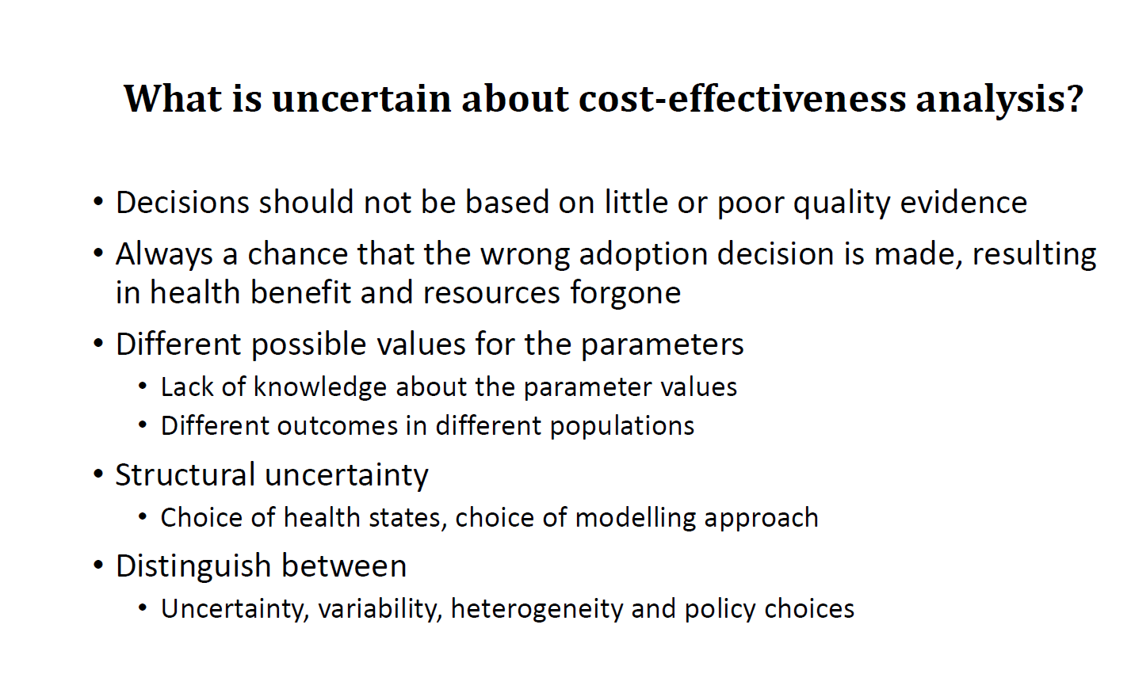
The repercussions of a wrong decision, founded on
inadequate evidence.
What crucial aspects have we overlooked in our CEA analysis?

Slide 20
Case 2

Slide 21
Case 2

Slide 22
Partitioned Survival Model
Case 2
Exponential
Weibull
Log-normal
Log-logistic
Generalized gamma
https://www.frontiersin.org/journals/oncology/articles/10.3389/fonc.2021.768035/full
Intervention group
Comparator group

Slide 23
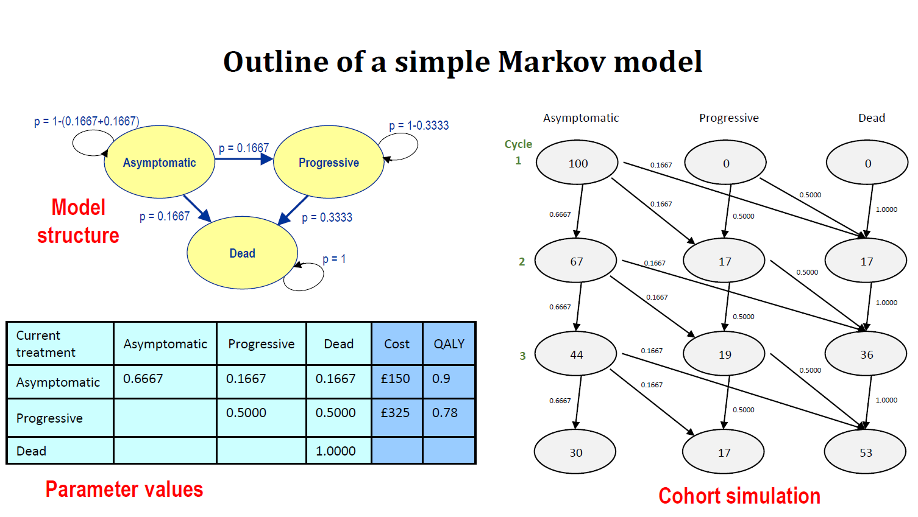

Slide 24
The repercussions of a wrong decision, founded on
inadequate evidence.

Slide 25
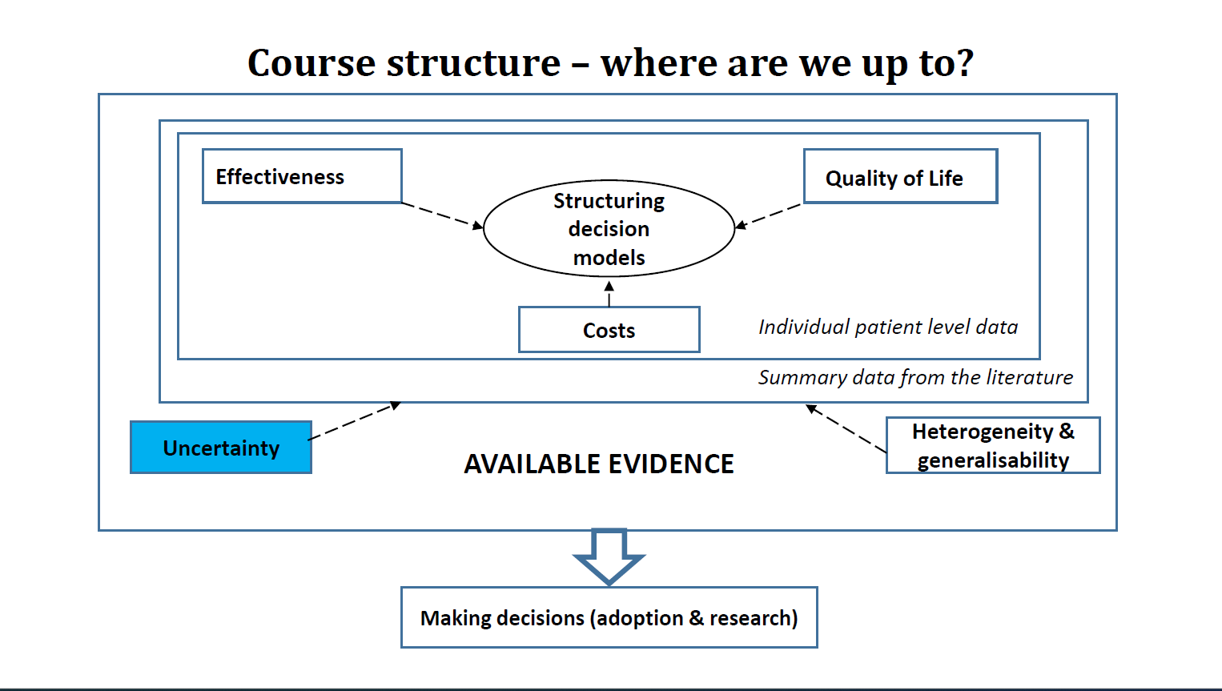

Slide 26
Q2. What are bias, variability, heterogeneity, uncertainty?
(Briggs: Box 2.1.; page 80-82)

Slide 27
Box 2.1. Key concept in understanding uncertainty and heterogeneity in decision models for cost-effectiveness analysis
Variability | Parameter uncertainty
Differ from individual patients clinical events that they experience, the associated health-related quality of life cannot be reduced through the collection of additional data | The precision with which an input parameter is estimated (e.g. probability of an event, a mean cost or utility) imprecision: input parameters are estimated for populations on the basis of limited available information uncertainty can be reduced through the acquisition of additional evidence
Decision uncertainty | Heterogeneity
Result in a distribution of possible cost-effectiveness relating to the options under comparison the distribution can be used to indicate the probability that the correct decision has been taken | Relates to the extent to explain a proportion of the interpatient variability in a particular measurement Ex: a particular clinical event may be more likely in men and in age ≥60 years possible to estimate input parameters (and cost-effectiveness and decision uncertainty) conditional on a patient’s characteristics (subgroup estimates)

Slide 28
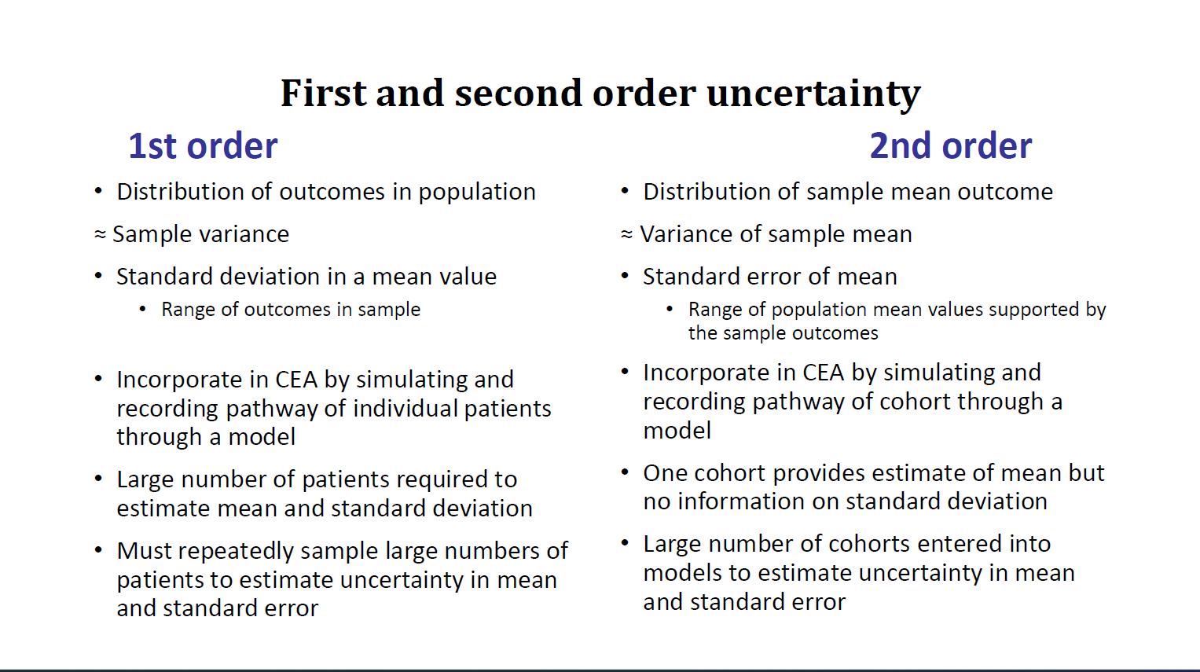

Slide 29
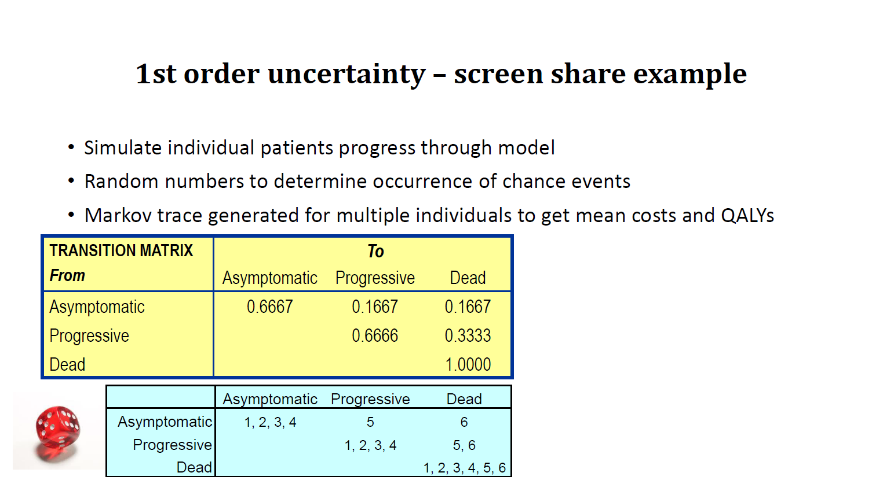

Slide 30
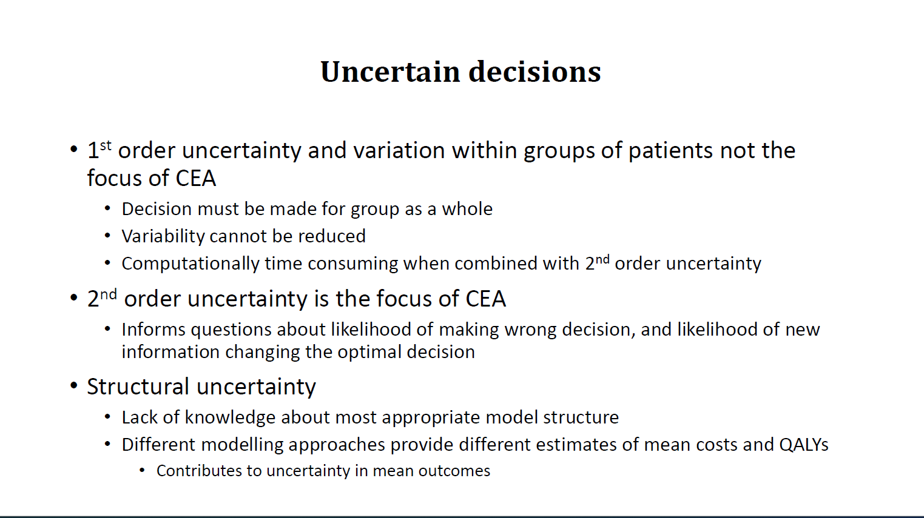

Slide 31
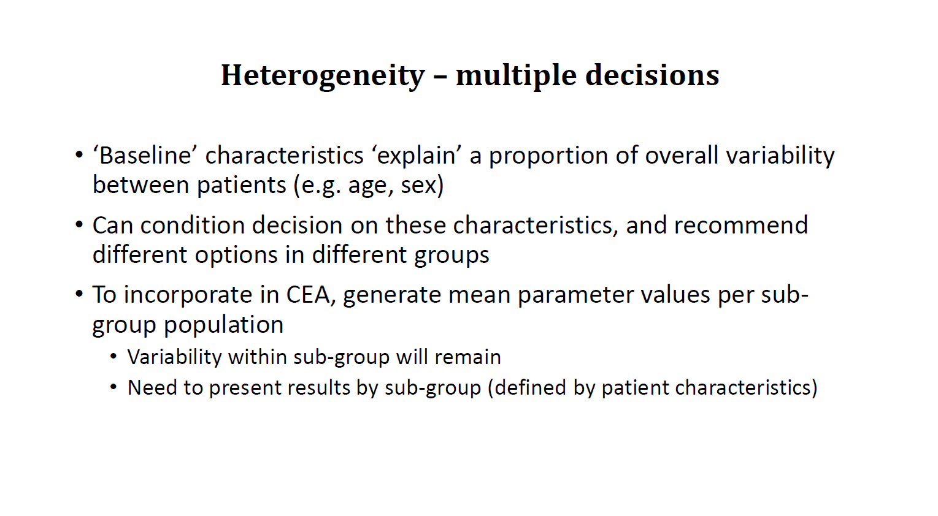

Slide 32
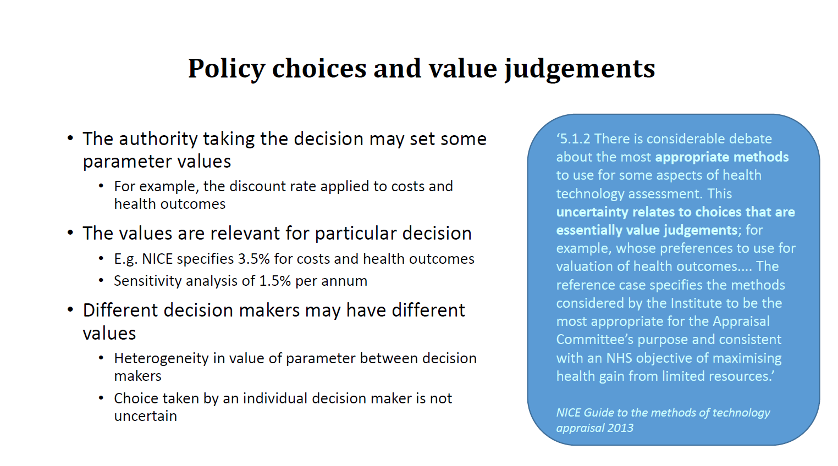

Slide 33
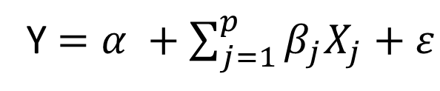
An analogy with regression(Briggs, page 83)
Y $=α +\sum_{j=1}^{p}{β_{j}X_{j}}+ε$

Slide 34
Q3: what should we focus on in CEA analysis?
Parameter uncertainty
Heterogeneity
Structural
Variability
Policy choice

Slide 35
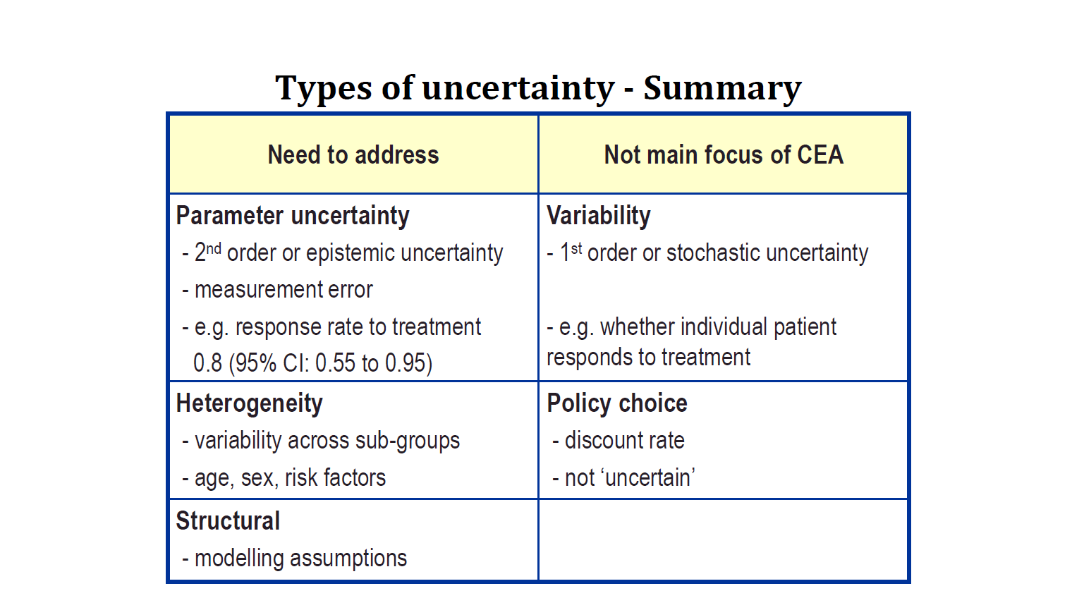

Slide 36
Q4: how to handle heterogeneity?
Data | Probabilities from binomial data | Probabilities from time-to-event data | Continuous variable like cost and utility
Model
E[Y]
Var(Y)
Distribution
Notes

